Slide 1
Public Safety calls
Data Analytics
Daniel Wingo
Linh Tran
Oana Dumitrescu
Saed SayedAhmed

Slide 2
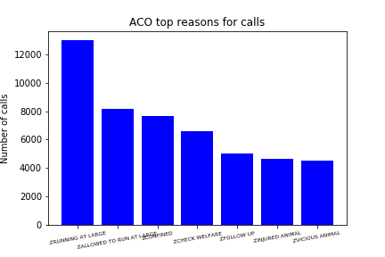
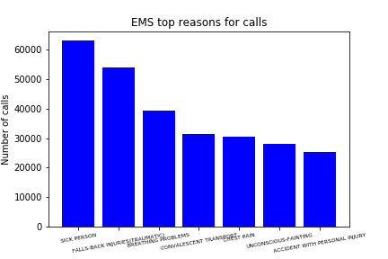
Top reasons why people call per agency

Slide 3
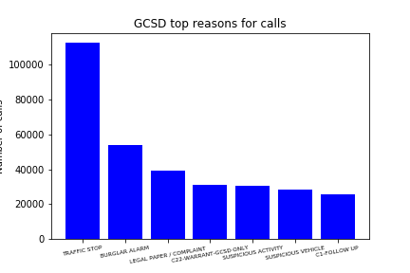
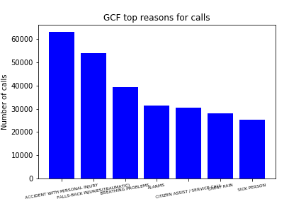
Top reasons why people call per agency

Slide 4
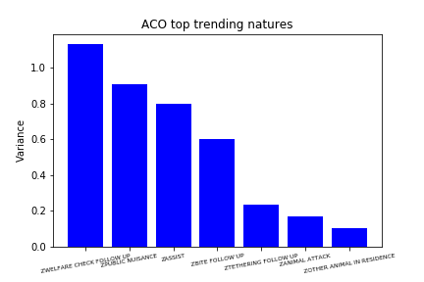
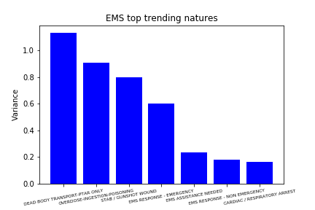
Natures with the biggest variance in calls

Slide 5
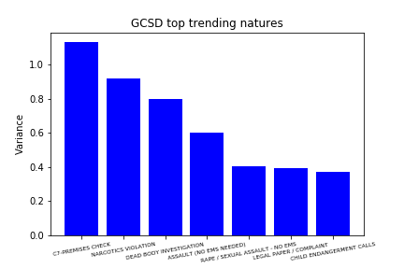

Natures with the biggest variance in calls

Slide 6
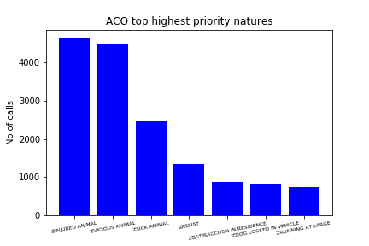
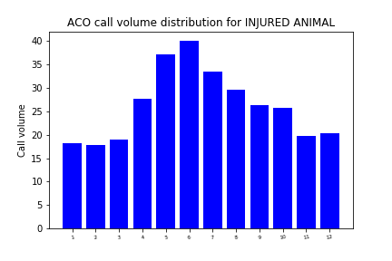
Natures with highest priority per agency-ACO

Slide 7
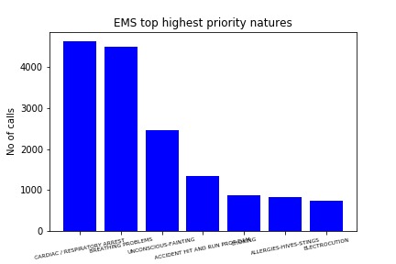
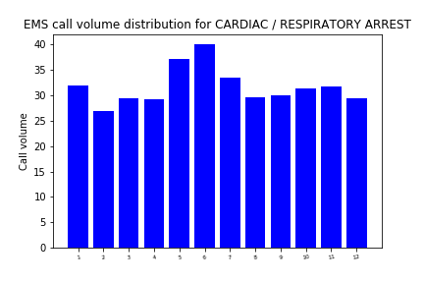
Natures with highest priority per agency-EMS

Slide 8

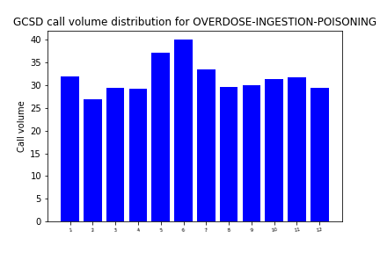
Natures with highest priority per agency-GCSD

Slide 9
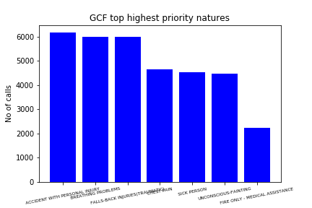
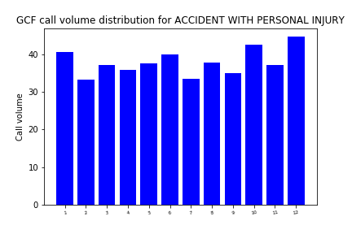
Natures with highest priority per agency-GCF

Slide 10
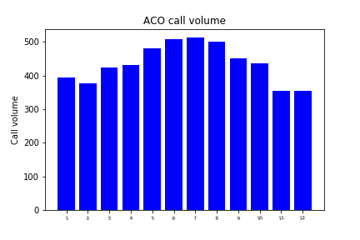
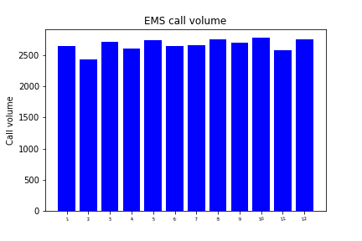
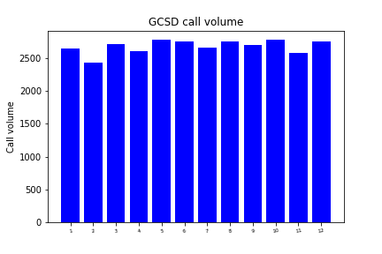

Bussiest months for each agency

Slide 11
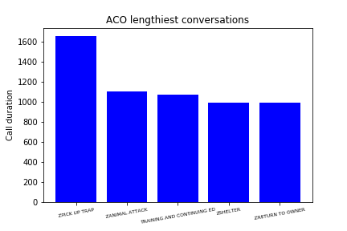

Phone call duration statistics per agency
ACO mean call duration-587 sec
Mean call duration for highest P nature INJURED ANIMAL-344 sec
EMS mean call duration-68 sec
Mean call duration for highest P nature CARDIAC / RESPIRATORY ARREST-26 sec

Slide 12


Phone call duration statistics per agency
GCSD mean call duration-51 sec
Mean call duration for highest P nature OVERDOSE-INGESTION-POISONING-42 sec
GCF mean call duration-23 sec
Mean call duration for highest P nature ACCIDENT WITH PERSONAL INJURY-21 sec

Slide 13
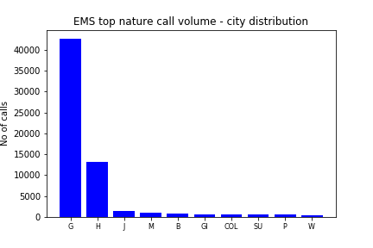
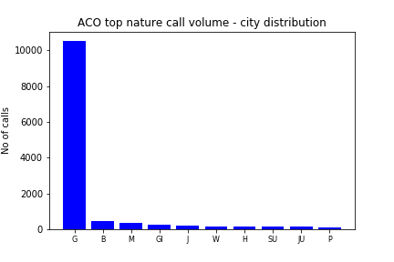
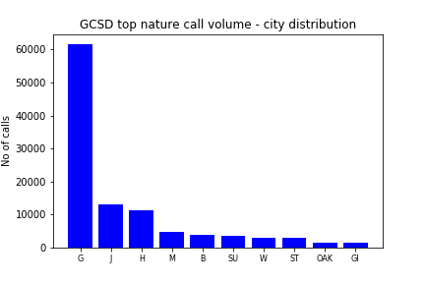

Patterns between geographic areas and top natures

Slide 14
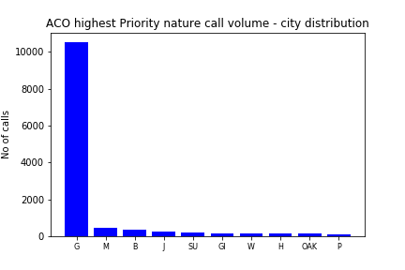
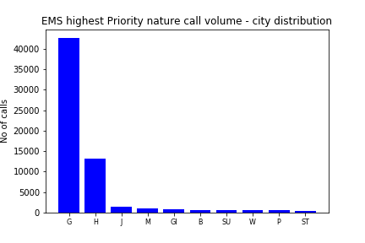
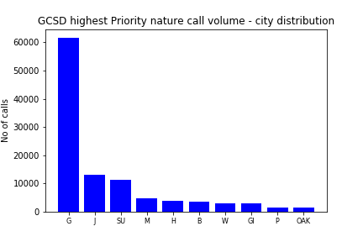

Patterns between geographic areas and highest Priority nature

Slide 15
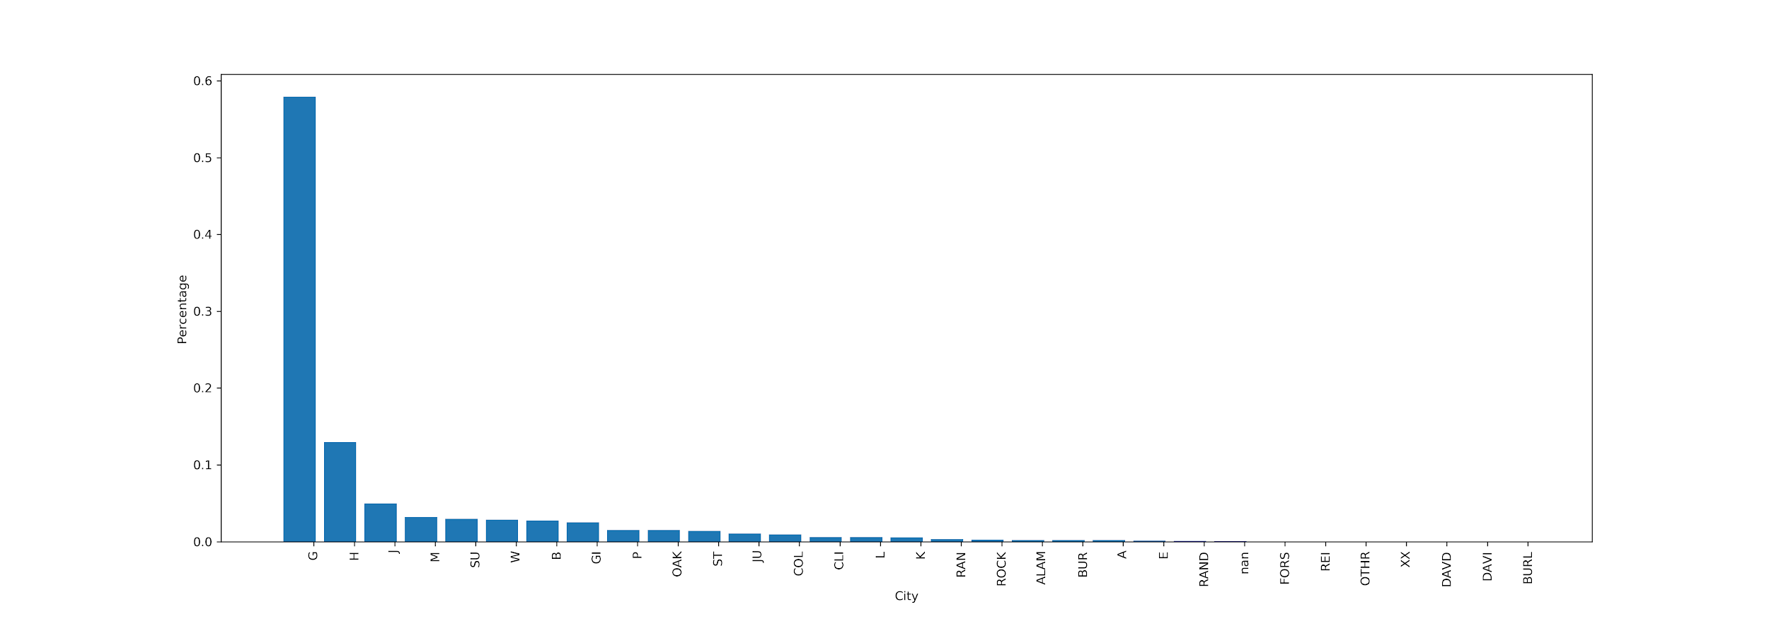
Call volume share among Guilford’s cities.

Slide 16
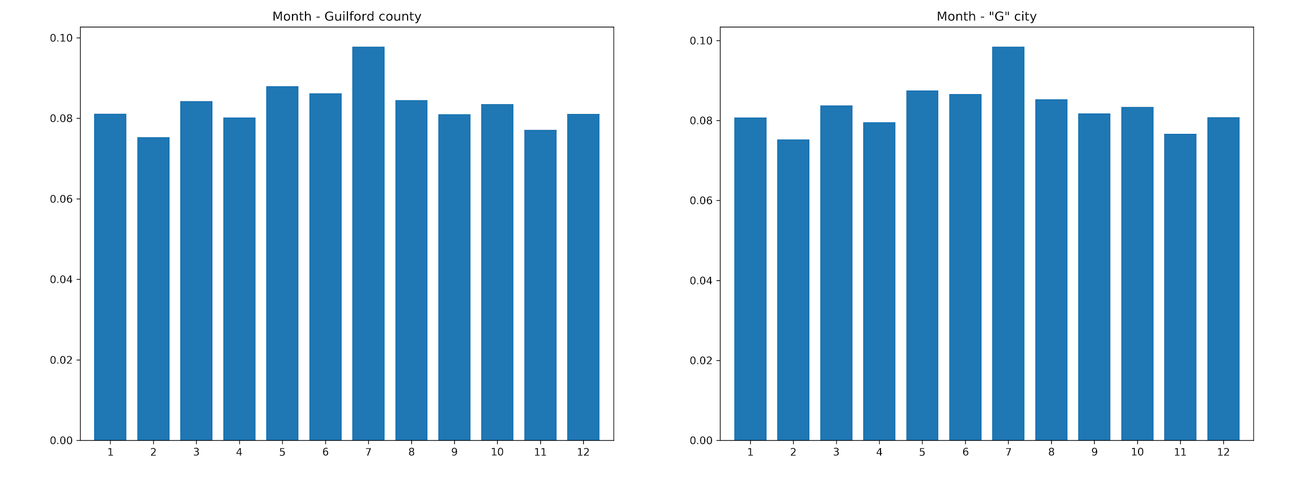
Call volumes per Month

Slide 17
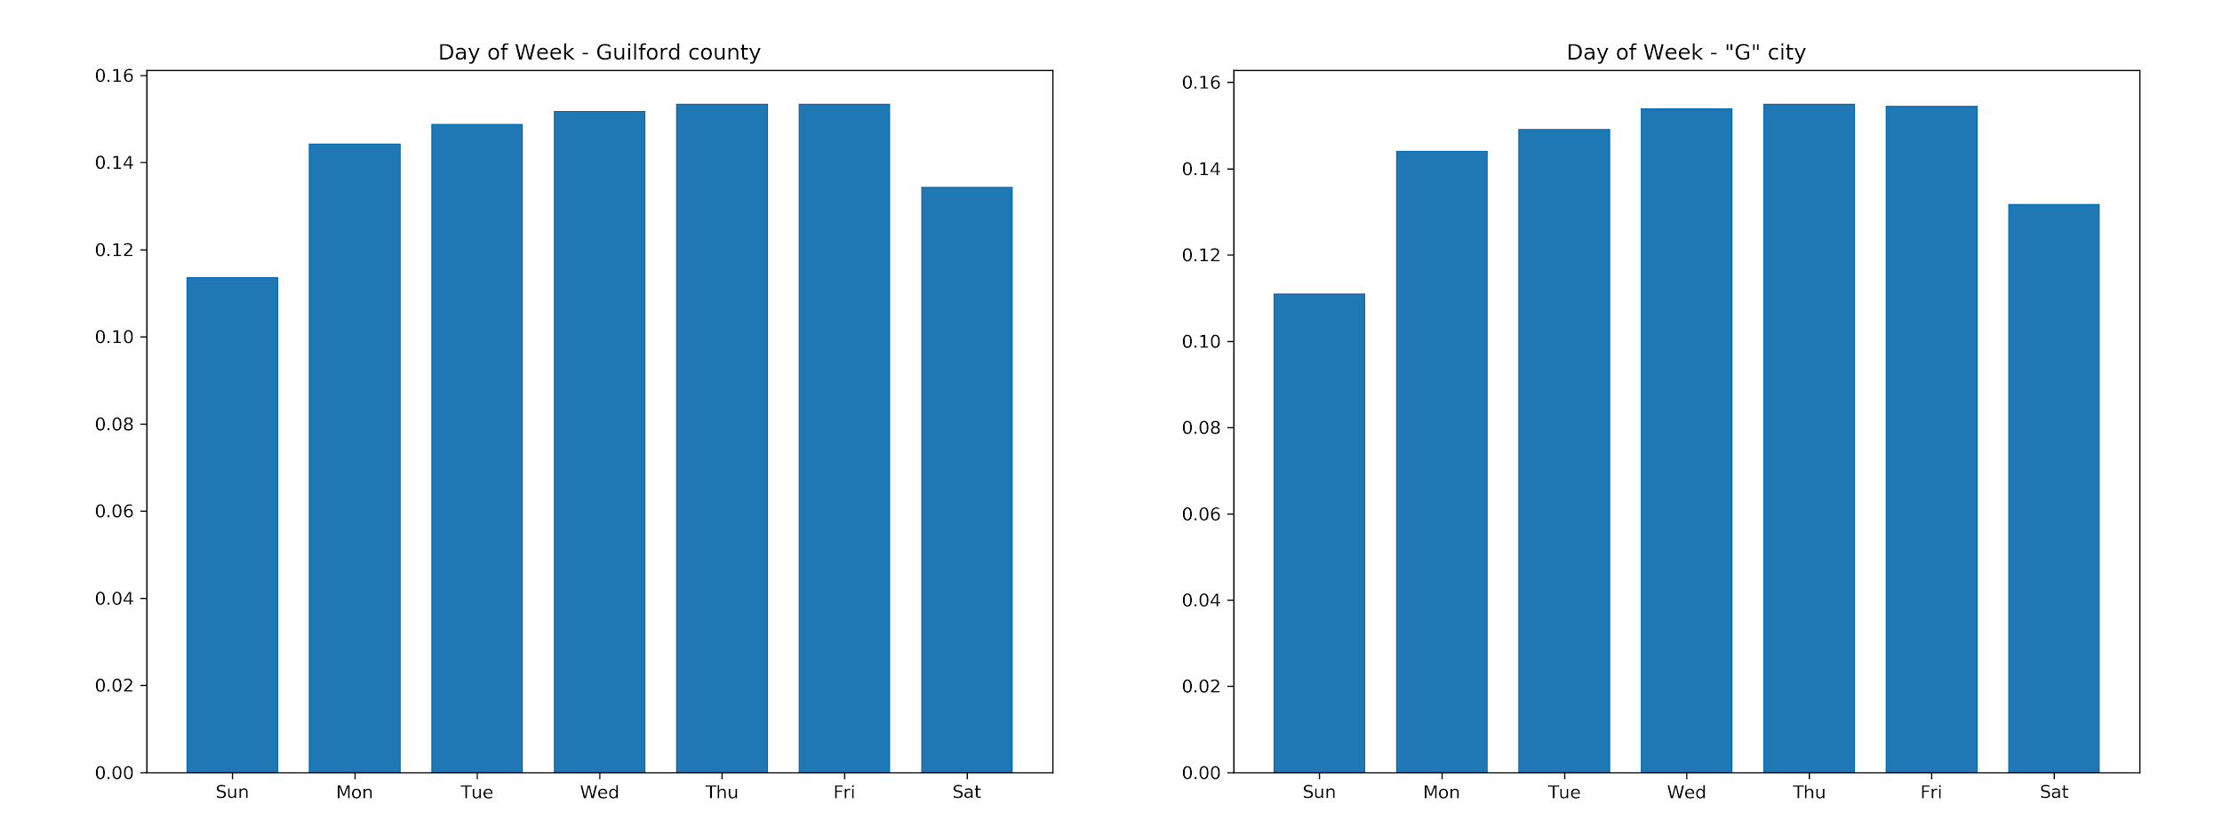
Call volumes per Day of Week

Slide 18
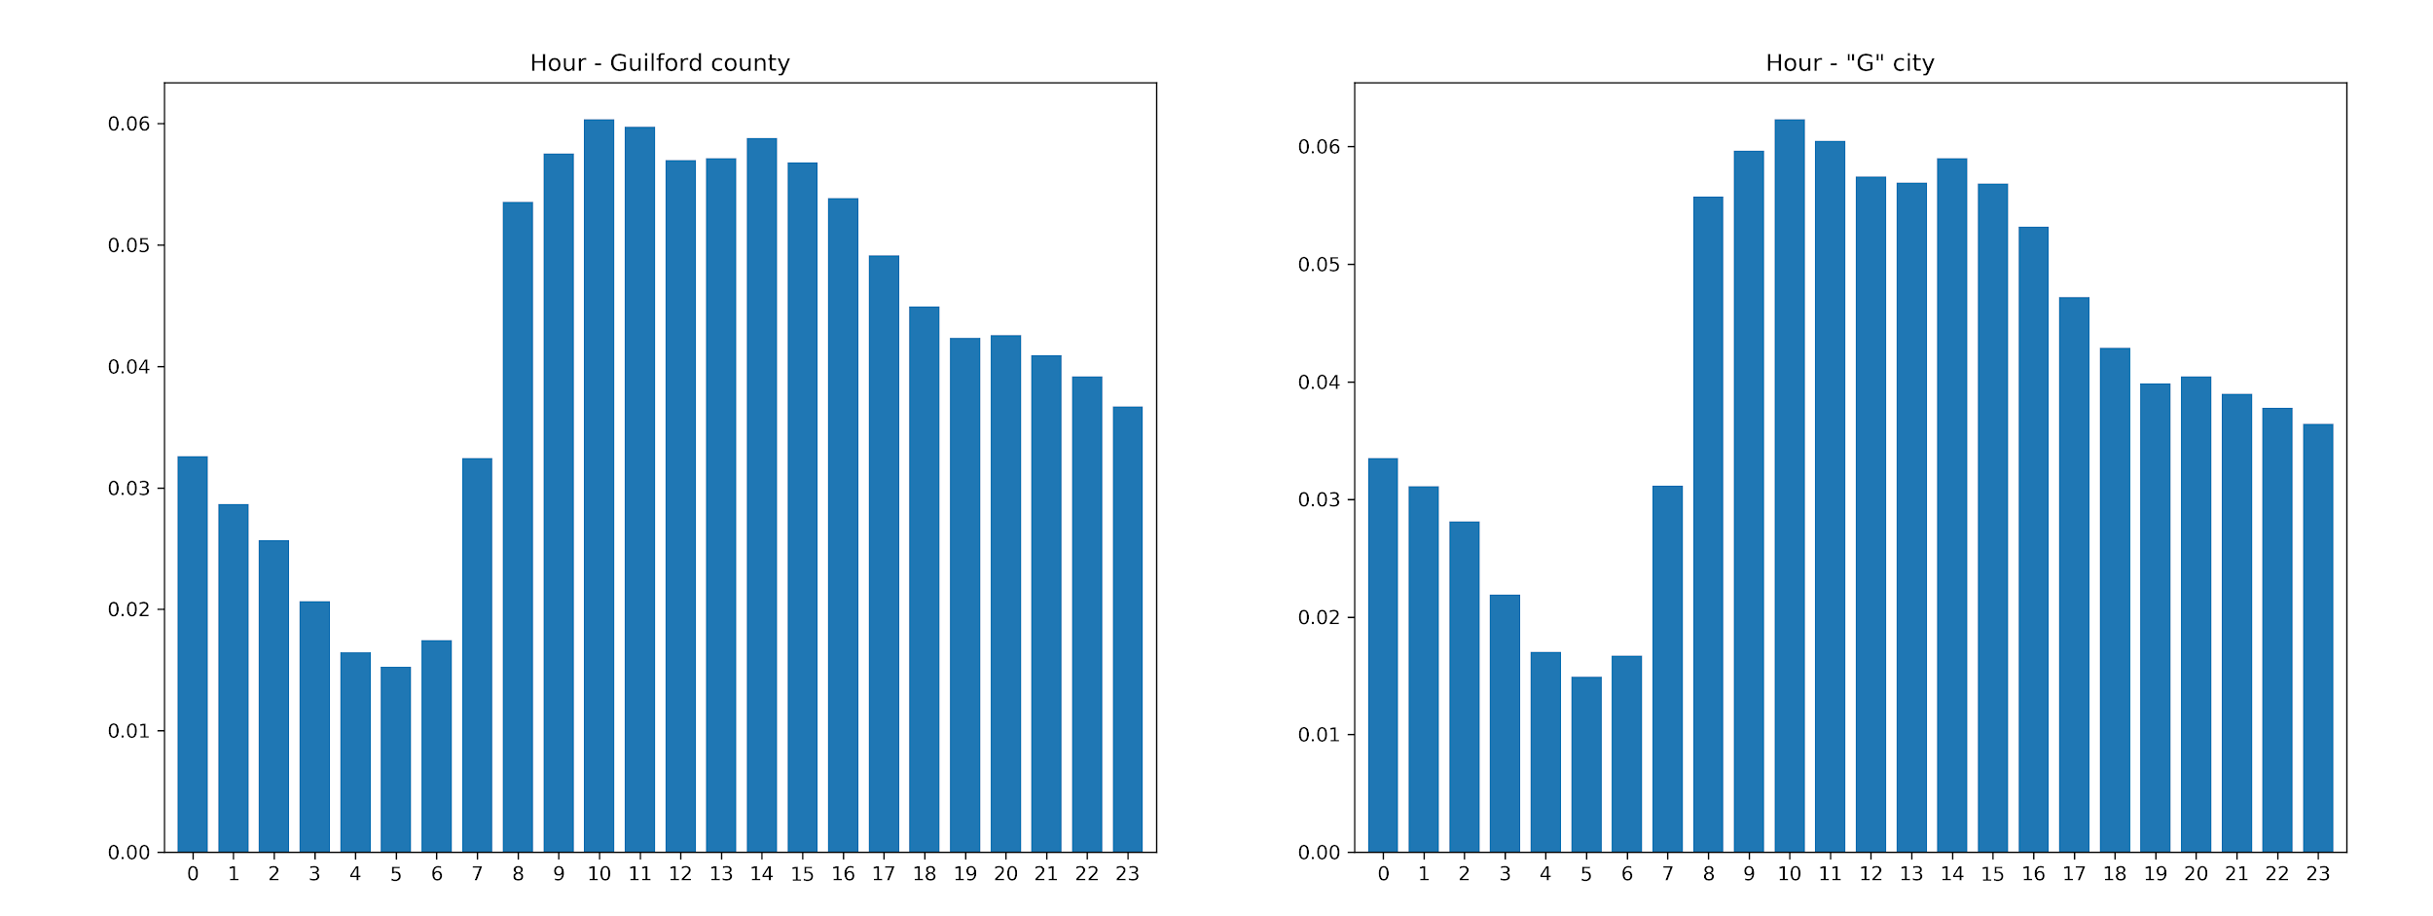
Call volumes per Hour

Slide 19
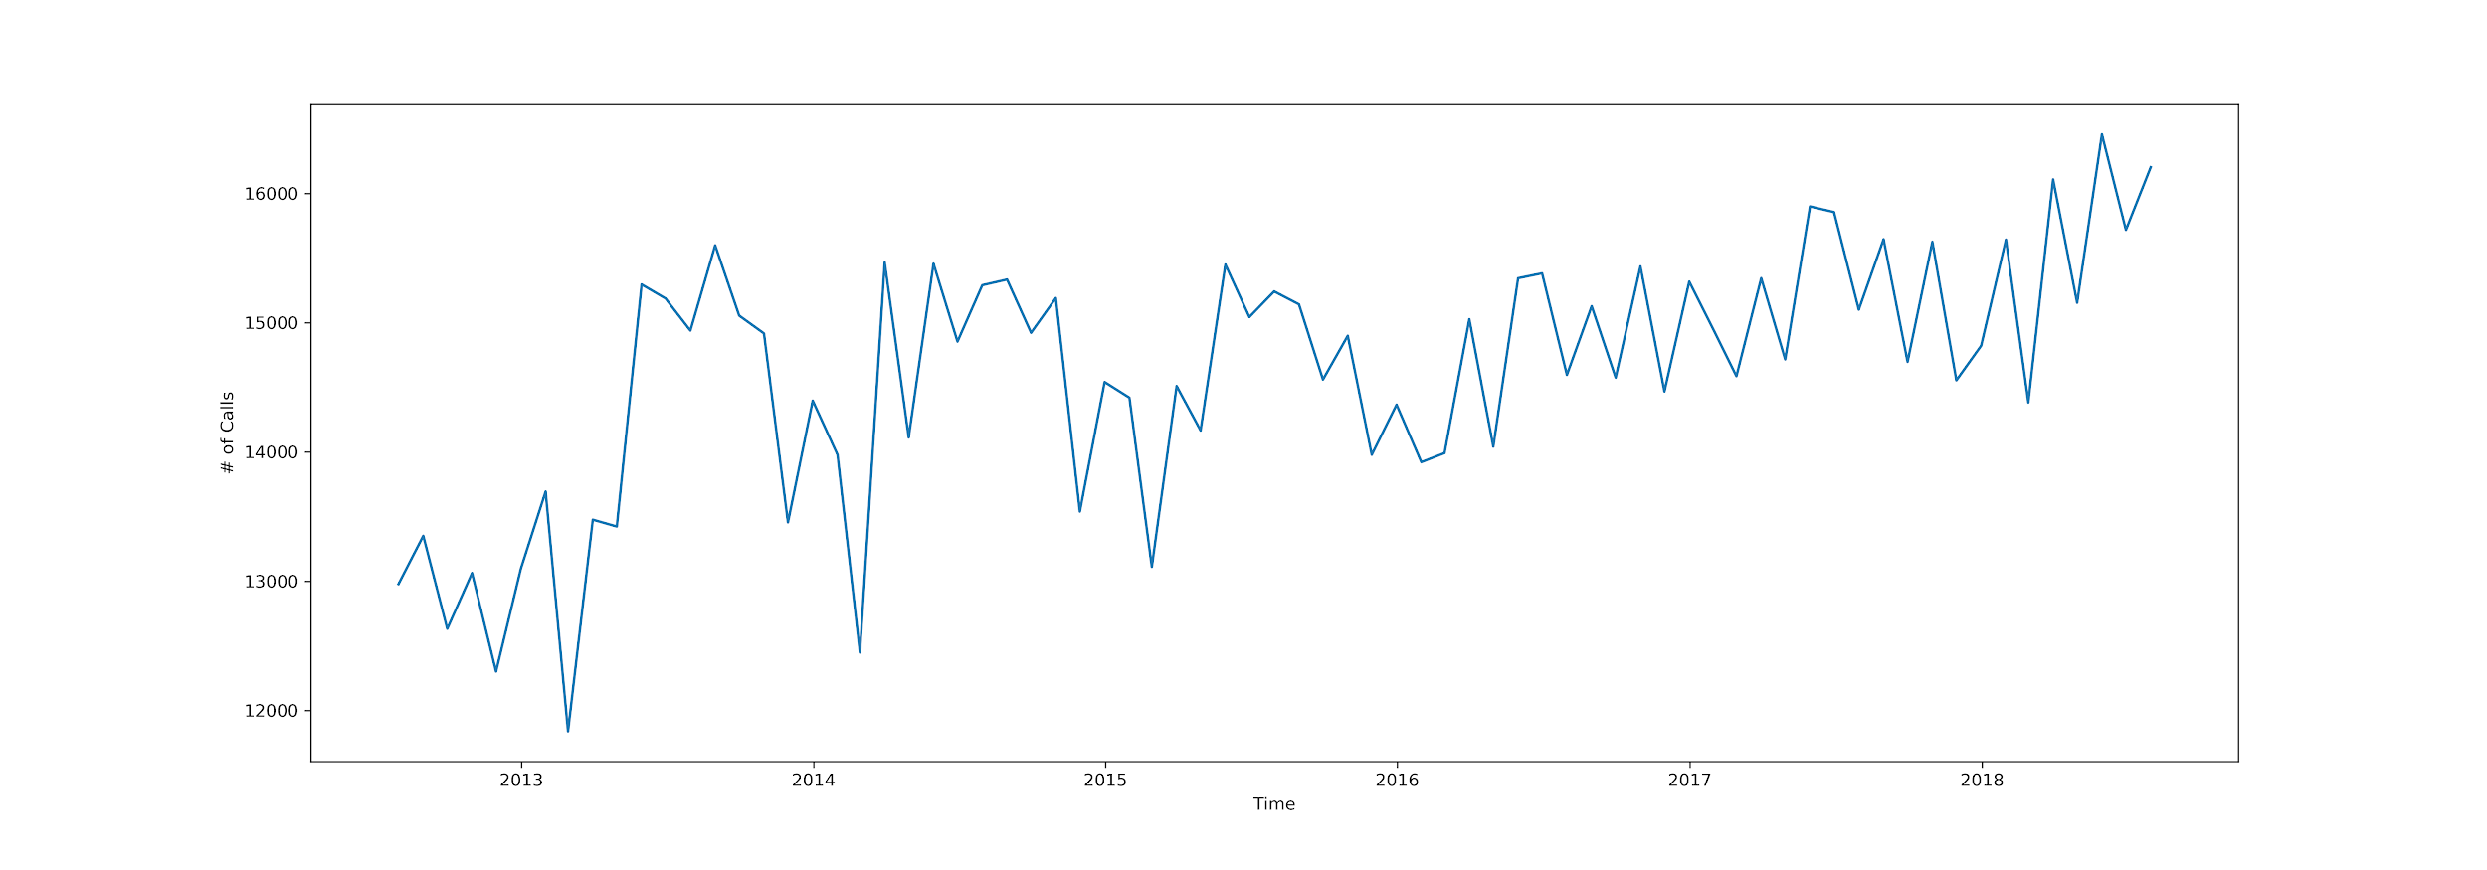
Changes along the years

Slide 20
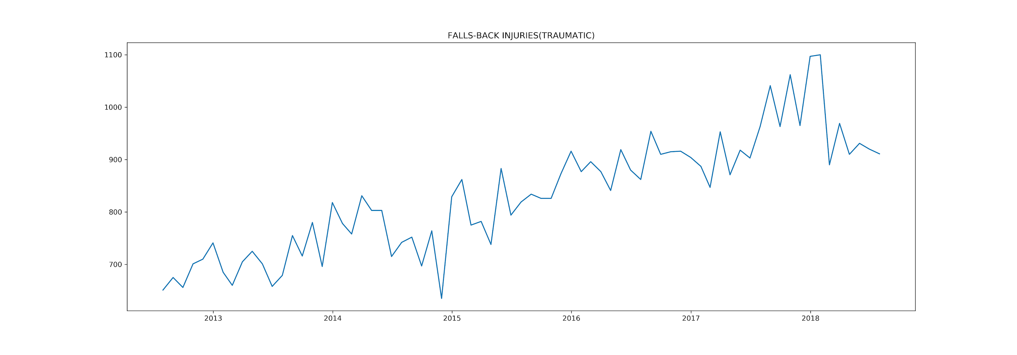
Changes along the years

Slide 21
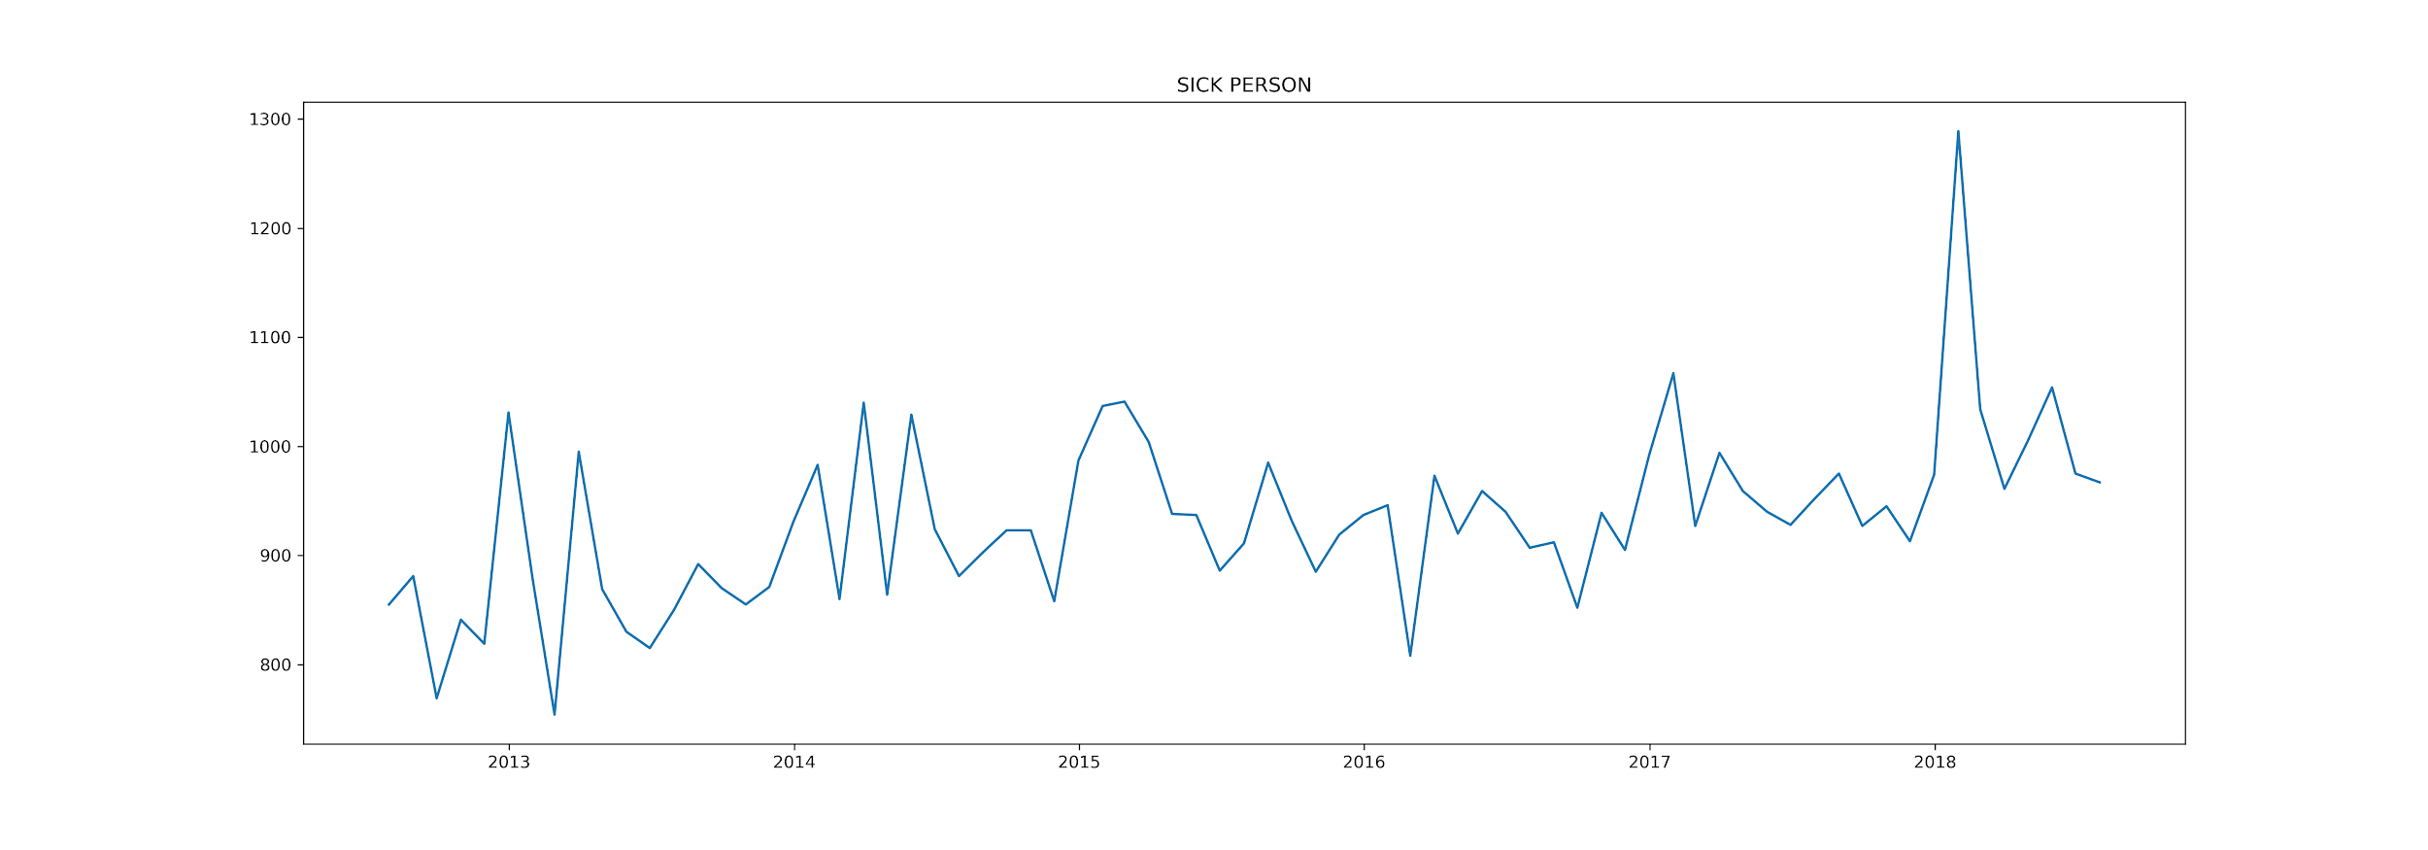
Changes along the years

Slide 22
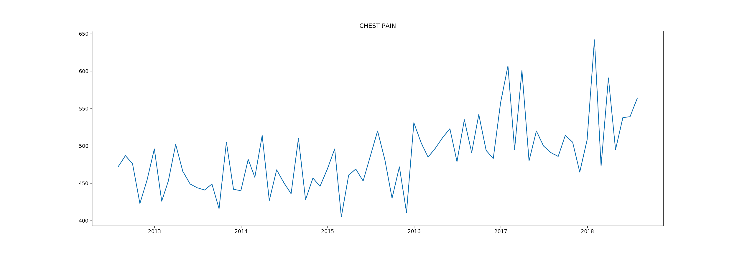
Changes along the years

Slide 23
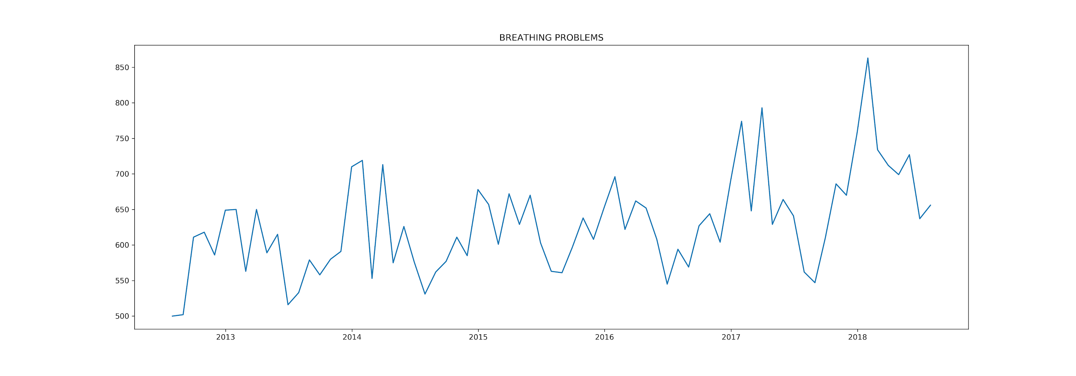
Changes along the years

Slide 24
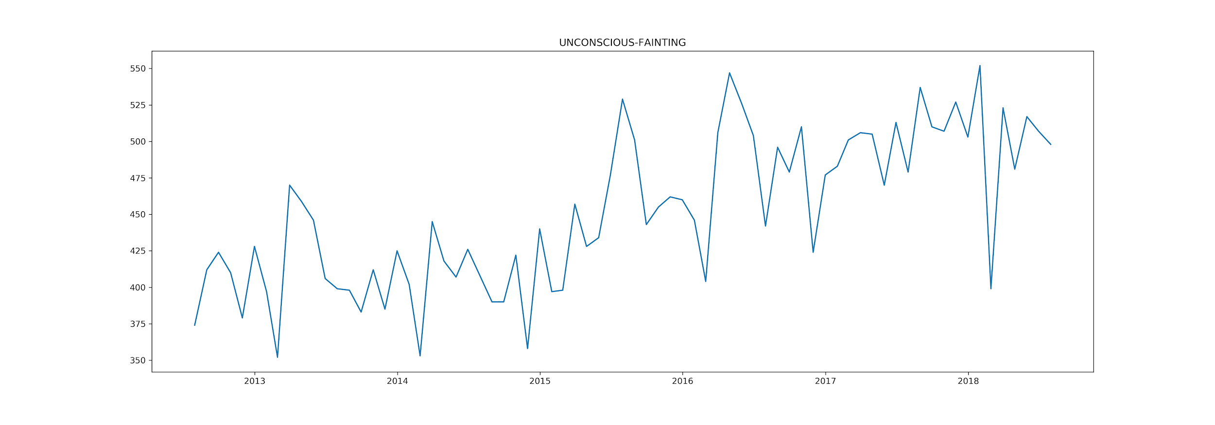
Changes along the years

Slide 25
Nature_ response time
Clean up data:
Filter out rows where nature = Transport to Animal Shelter
Split calltime into more than one field
Drop unnecessary Columns

Slide 26
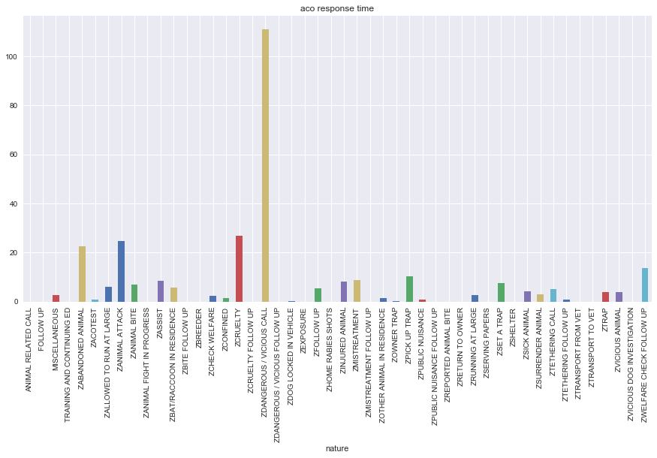

Slide 27
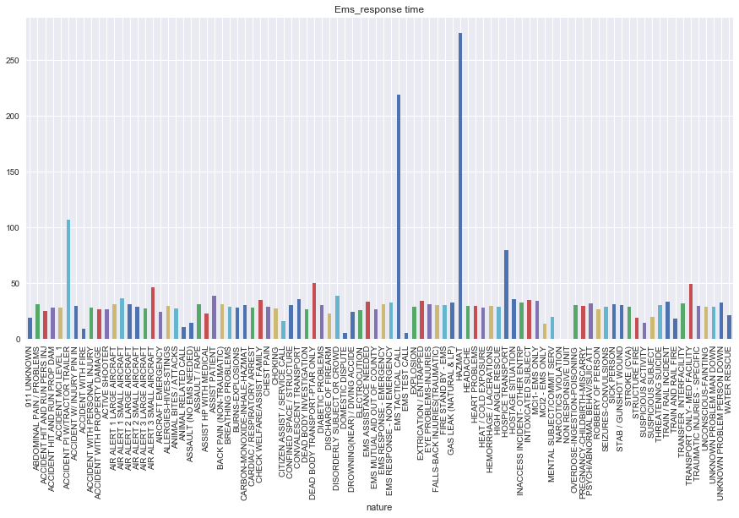

Slide 28
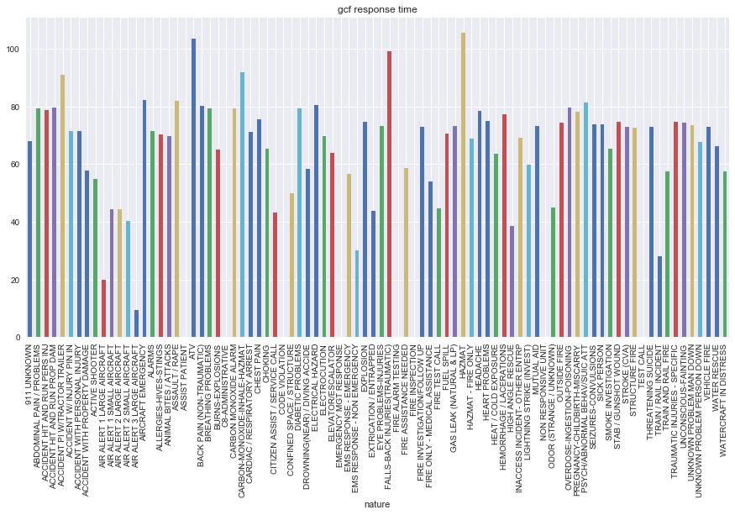

Slide 29
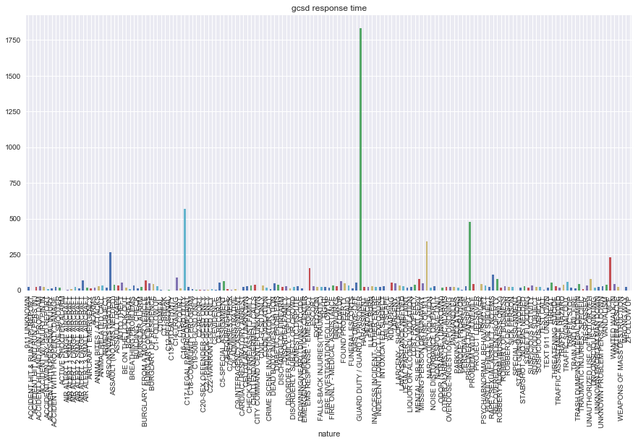

Slide 30
Future tasks:
Find out what time of year the agency response the quickest
Does the agency response time improve/ decrease over the year

Slide 31
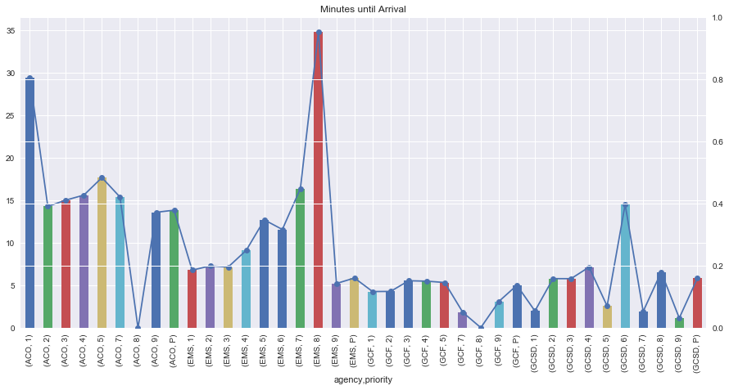
Priorities

Slide 32
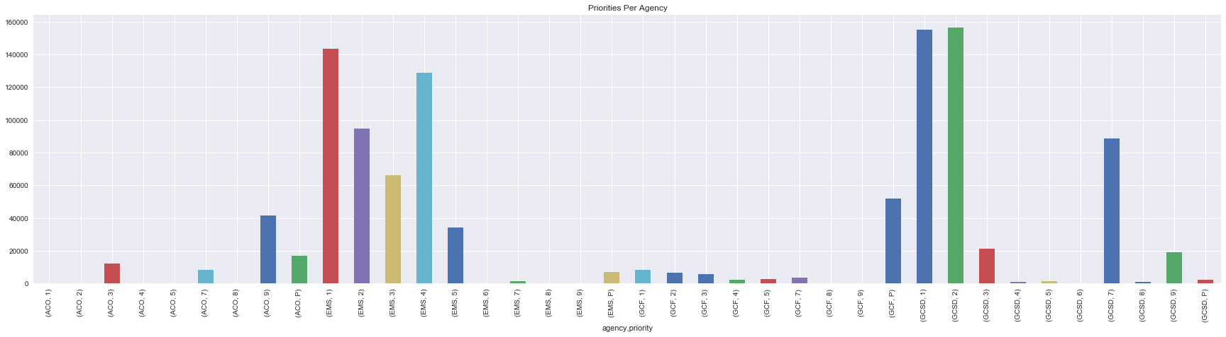

Slide 33
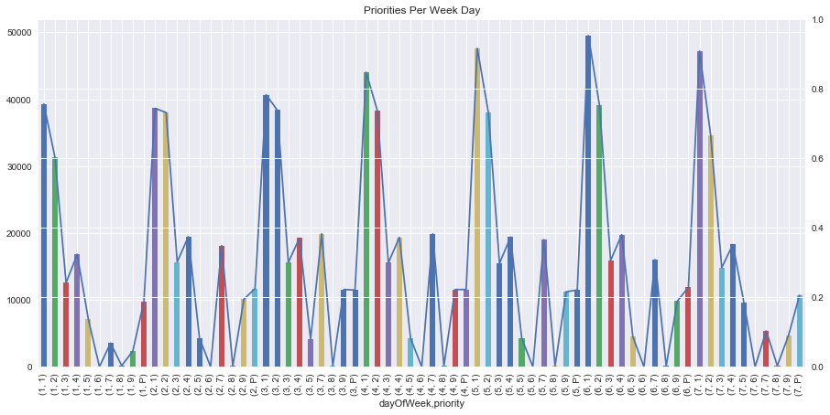

Slide 34
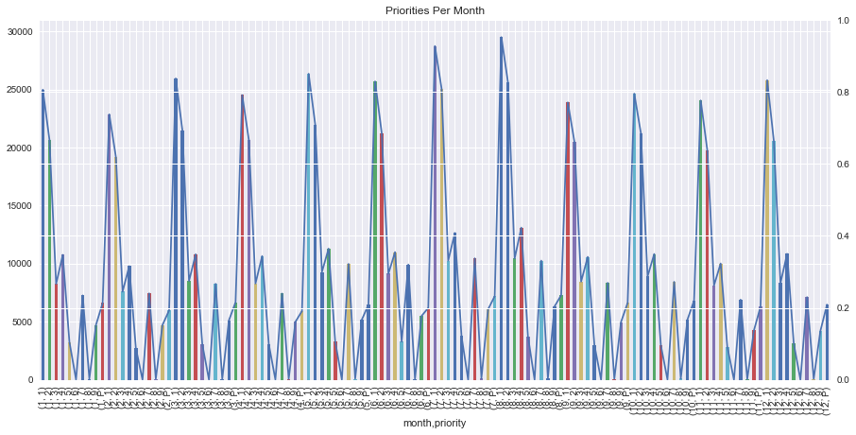

Slide 35
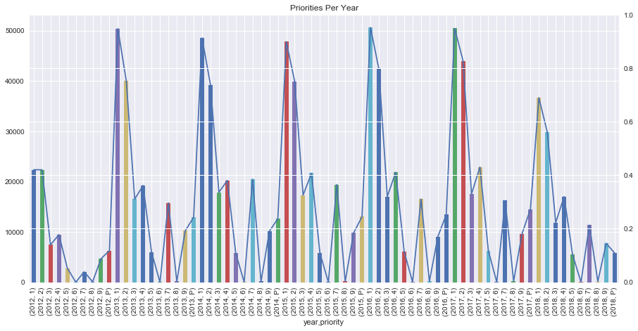

Slide 36
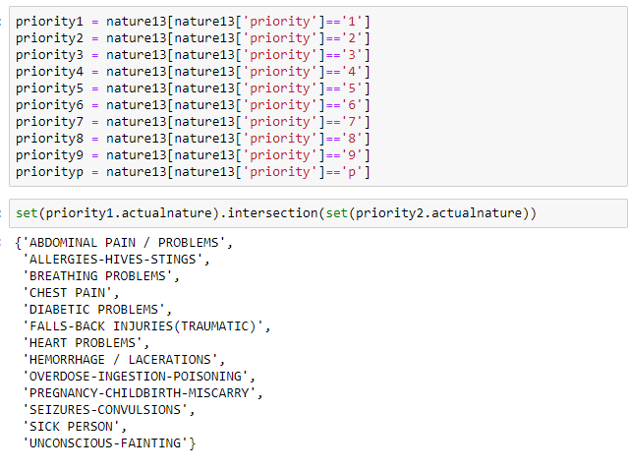
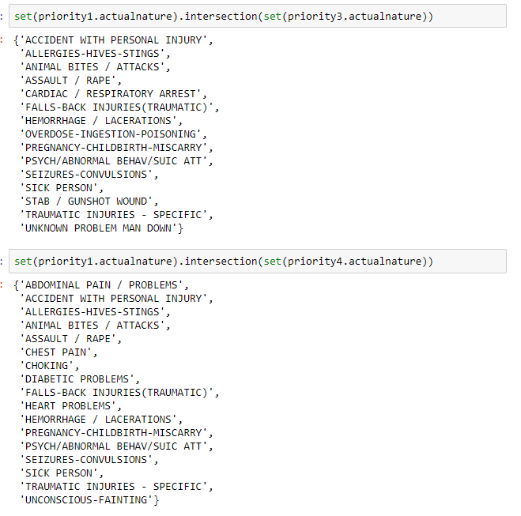
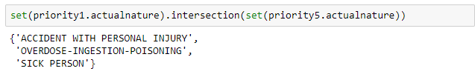
Original Question
Do the Priorities change over the years?
PROBLEM!
This shows us that the idea that the priorities being solely based on the nature is FALSE. If there are overlapping in priorities with in the first year it would be very difficult to find a way to show how priorities have changed throughout the years. I understand why they would overlap after looking at the natures that did overlap. We assumed they would have similar titles. We just don't assume they would have them same titles. I understand it priority would be based on the nature and the severity of nature.

Slide 37
Future tasks
For some ‘key’ natures, apply machine learning to predict them (Oana)
Use k-nearest neighbours to predict where new hospitals/fire dept/animal shelters should be built based on the location from where the calls are made (Oana)
Use geolocation data to identify clusters and for public interest clusters (UNCG, downtown, etc) identify which are the top/highest priority reasons people call about(Oana)

